Slide 1

Pilgrimage
Group 5: Gabriel Mureşeanu, Abraham Nataniel

Slide 2

Design Challenge
Our Design Challenge was to make a 3D adventure/platformer game that focuses on the exploration aspect of the world, where we encourage players to explore the world and make the world engaging as well.

Slide 3
Analysis

Slide 4

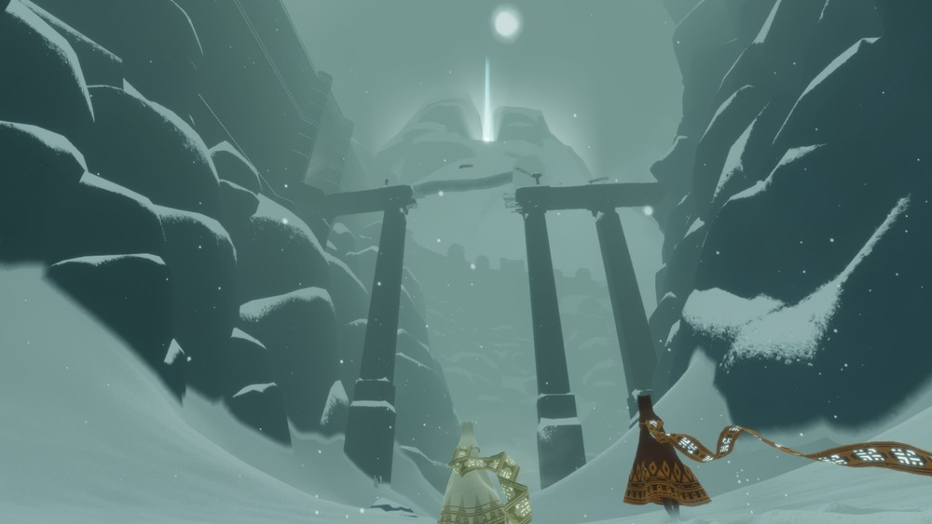
Game Research
As for the inspiration of the game, The Last Guardian and Journey were big inspirations in the making of our game
The idea was to make the game with similar style but make it First-Person and more complex movement system.

Slide 5

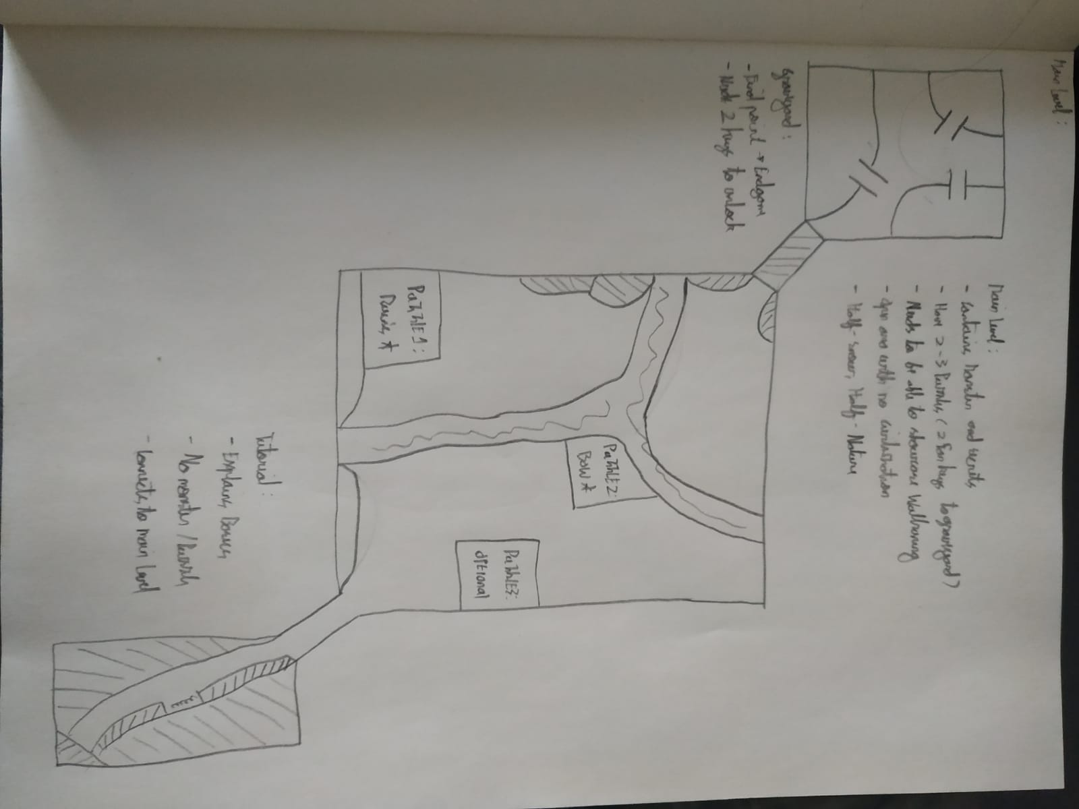
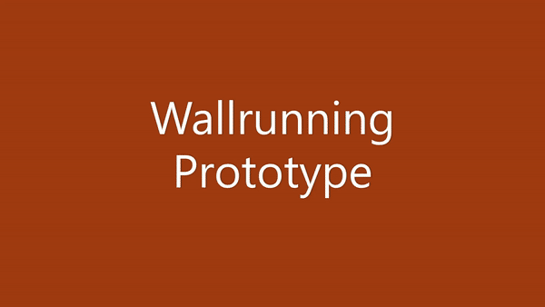
Protoypes
In designing the game, we resorted to the very basic: paper protoyping, to vizualize all of our Ideas.
After We finished the protoyping, we began designing our protoypes in unity.

Slide 6
Design

Slide 7
Design Documents
We made two Game Design documents:
Pilgrimage Concept Design (1-page Game Design Document)
10-page Game Design Document

Slide 8
Prototype Designs
Movement

Slide 9

Prototype Designs
Puzzle

Slide 10
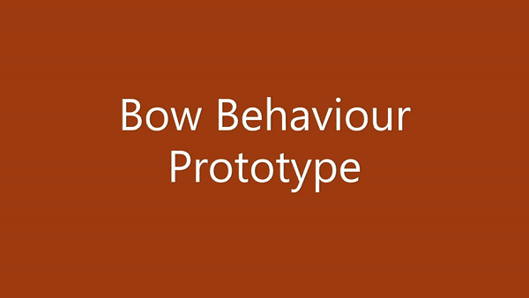
Prototype Designs
Bow

Slide 11
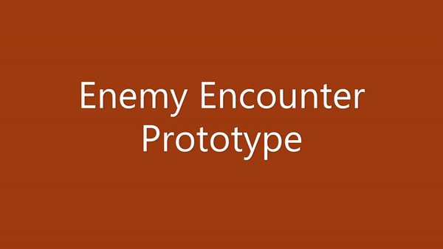
Prototype Designs
Enemy Encounter

Slide 12
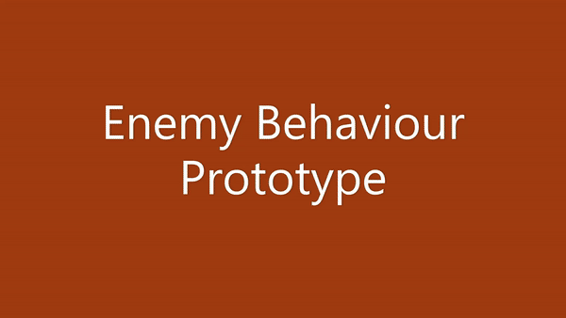
Prototype Designs
Enemy Behaviour

Slide 13
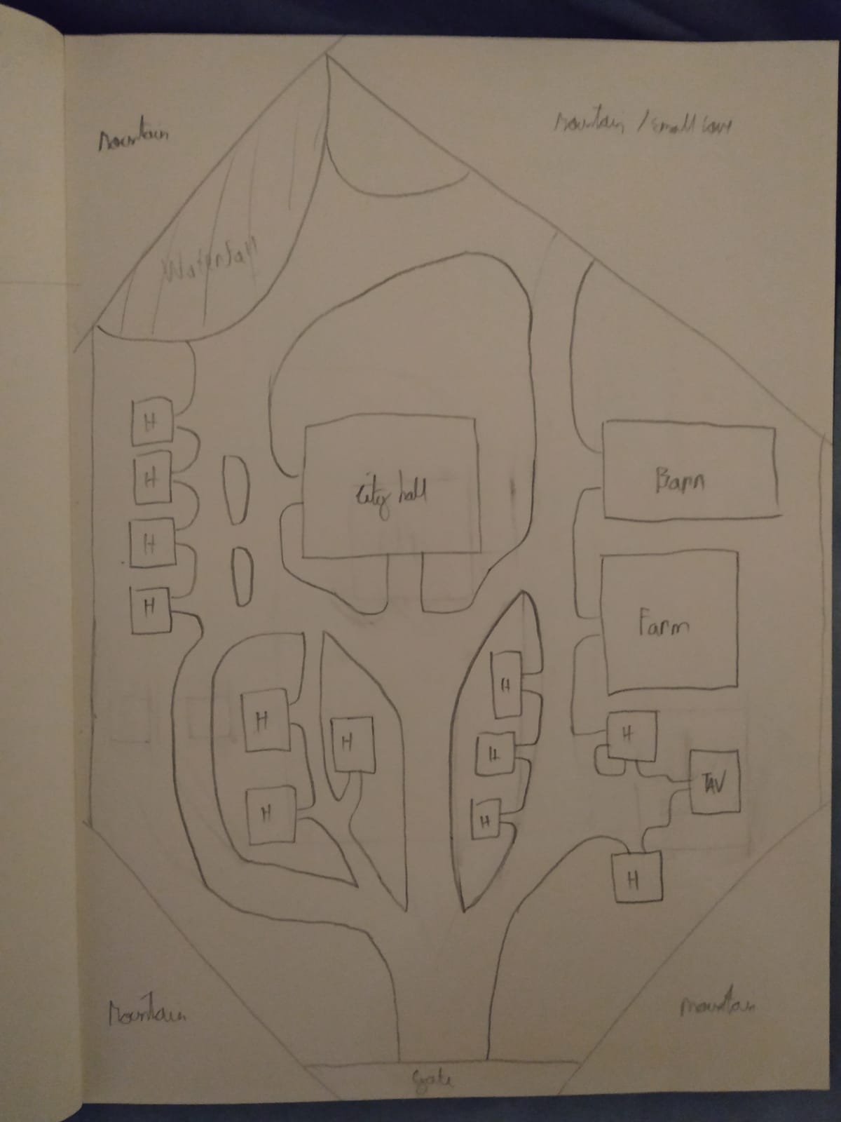
Level Sketches
These are the two initial sketches for the level design.
The left is the main level and the right is the HUB.

Slide 14
Realization

Slide 15
Playable Prototypes
Unfortunately since we were quite tight on our timing, we only managed to make 1 playable prototype just to show the mechanics of the game plus also the sound implementations of the game.
Link: Pilgrimage Play Test 1 by ABELiusSimarjutangkus (itch.io)

Slide 16

Sound Implementation
Our initial sound design challenge was:
Footsteps, enemy, and bow sounds
Atmospheric sounds (Both in Seliana and Valaris)
Background music
The outcome is as such:
For the first challenge, we managed to implement it and we are quite happy with the results.
For the second challenge, we also managed to implement it so that our world feels more lively and natural, hence we are happy about the results.
For the third challenge, we did implement it, but decided to go against it because it clashes with our atmospheric sounds.

Slide 17
Validation

Slide 18
Insights and Technical Validation
Based on the playtest result that we received on our final build, we received a pretty good feedback. Many of our testers seem to enjoy the game, albeit they mention that there are things need improving
Link: https://docs.google.com/forms/d/1tVVEOfy5sM9W6h1MgeTVH8plUz7oE2zgqFkwFdsb0us/edit?usp=sharing

Slide 19
Devlog links
Abraham: https://abraham-nataniel18.gitbook.io/your-own-game-devlog/
Gabriel: https://app.gitbook.com/@snechboii/s/dev-log/

Slide 20
Reflection
Gabriel:
I think that for our design goal we reached most of it except the story, due to the fact that the story takes a lot of time to implement. I am happy with most of the goals achieved except with our main character, as we didn't have time to implement a model for it, I would've also likes to work with inverse kinematics for better animations for stuff like clamping and auto-generated animations for the running and bow shooting. I am proud of the AI, as it's the first time I coded one, however I'm not really satisfied with it as it could've been much better than what it currently is if we had more time. I think we nailed the design of the world and made it feel quite nice for a game developed over the course of 5 weeks.
Abraham:
In my opinion, I am very satisfied with what Gabriel and I achieved in 5 weeks. I learned many things, but most importantly I learned how difficult it is to make even a simple game like this. I do believe that we achieve most of our goals. We implemented all of the desired mechanics and almost all of the sounds are implemented as well. I am especially proud with the puzzles that I created as well as the inventory system and level designs that I made for this game. This was a challenging project for me as before this course I had no experience in game development. Hence, to be able to finish this game within the desired time, I am very pleased with the result.

